Slide 1
Fantasy Football Predictions
Senior Project
By Mariel Berger and Zach Nelson

Slide 2

What is Fantasy Football?
- Fantasy football is a game where the players act as "owners" and "managers" of teams, accruing "fantasy points" based on the statistics of real football players.
- Leagues are scored on a weekly basis, matching up teams in a head-to-head scenario in a rotating schedule.
- The goal is to collect the most productive players across a variety of positions to get the most fantasy points in their league.
- 59.3 Million people play Fantasy Football

Slide 3
Project Description
- One stop shop website for all the Fantasy Football information you need to make your next best selection for your team
- This website is a tool for Fantasy Football players to utilize all the statistics it provides and use the calculator to compute total possible fantasy points
Languages used:
- Java
- HTML
- JSON
- Python

Slide 4
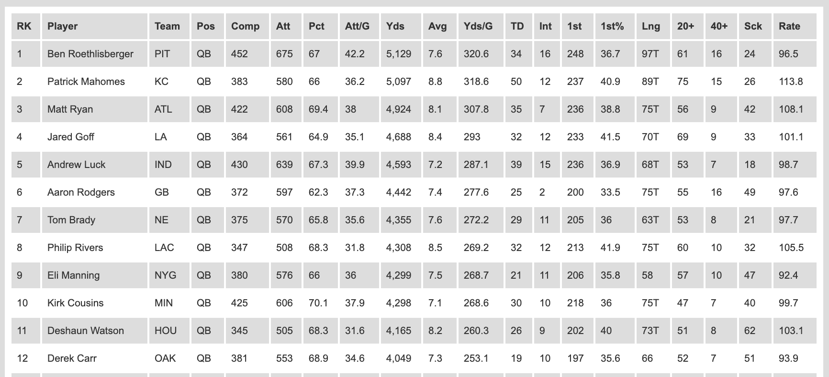
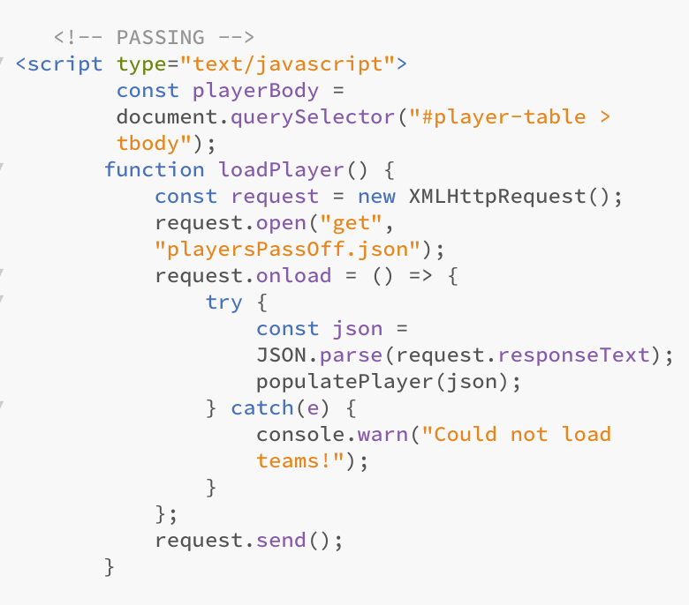
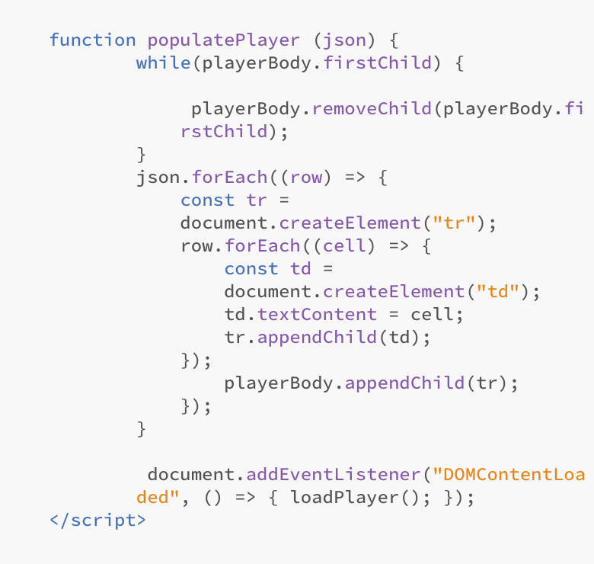
Using JavaScript to Display JSON Data in a Table
Notes:
A big part of our website is displaying the nfl players’ and teams’ data in a way for website users to see in a helpful way.

Slide 5

Home Page
Notes:
This is our homepage where there are links to our subpages such as Players, Teams, Spreads, and Calculator.

Slide 6
Players Page

Slide 7
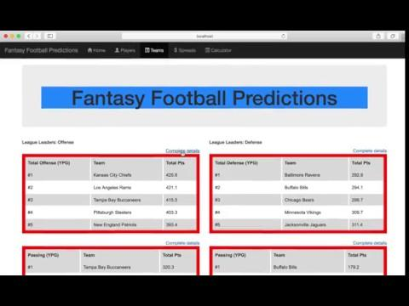
Teams Page

Slide 8
Spreads Page

Slide 9
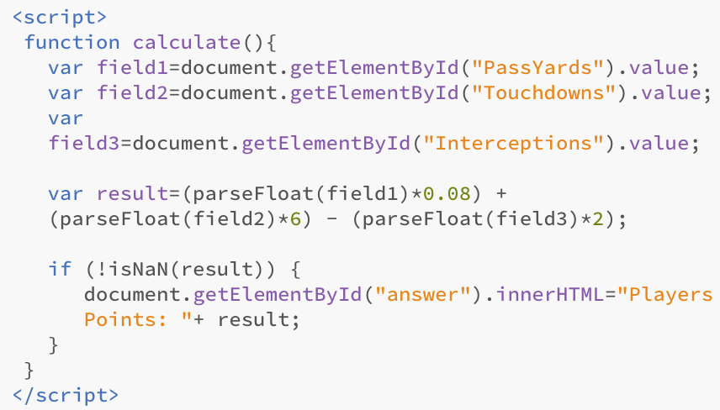
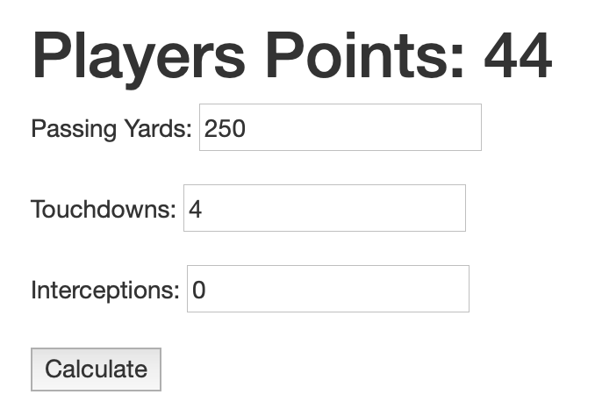
Calculator Page
Website View
The Code

Slide 10

Linear Regression
- Linear Regression is a way to explain and model the relationship between a dependant variable and one or more explanatory variables.
- Linear regressions are often used to create predictive models using data sets that are useful for making predictions, forecasting, and reduction.
- Linear regressions, along with many other algorithms called sabermetrics, are used for creating statistical analysis of sports data. In recent years it was used by the Oakland A’s in the early 2000’s, which inspired the book and movie Moneyball. Statistical analytics have become a major facet in modern sports especially baseball.

Slide 11
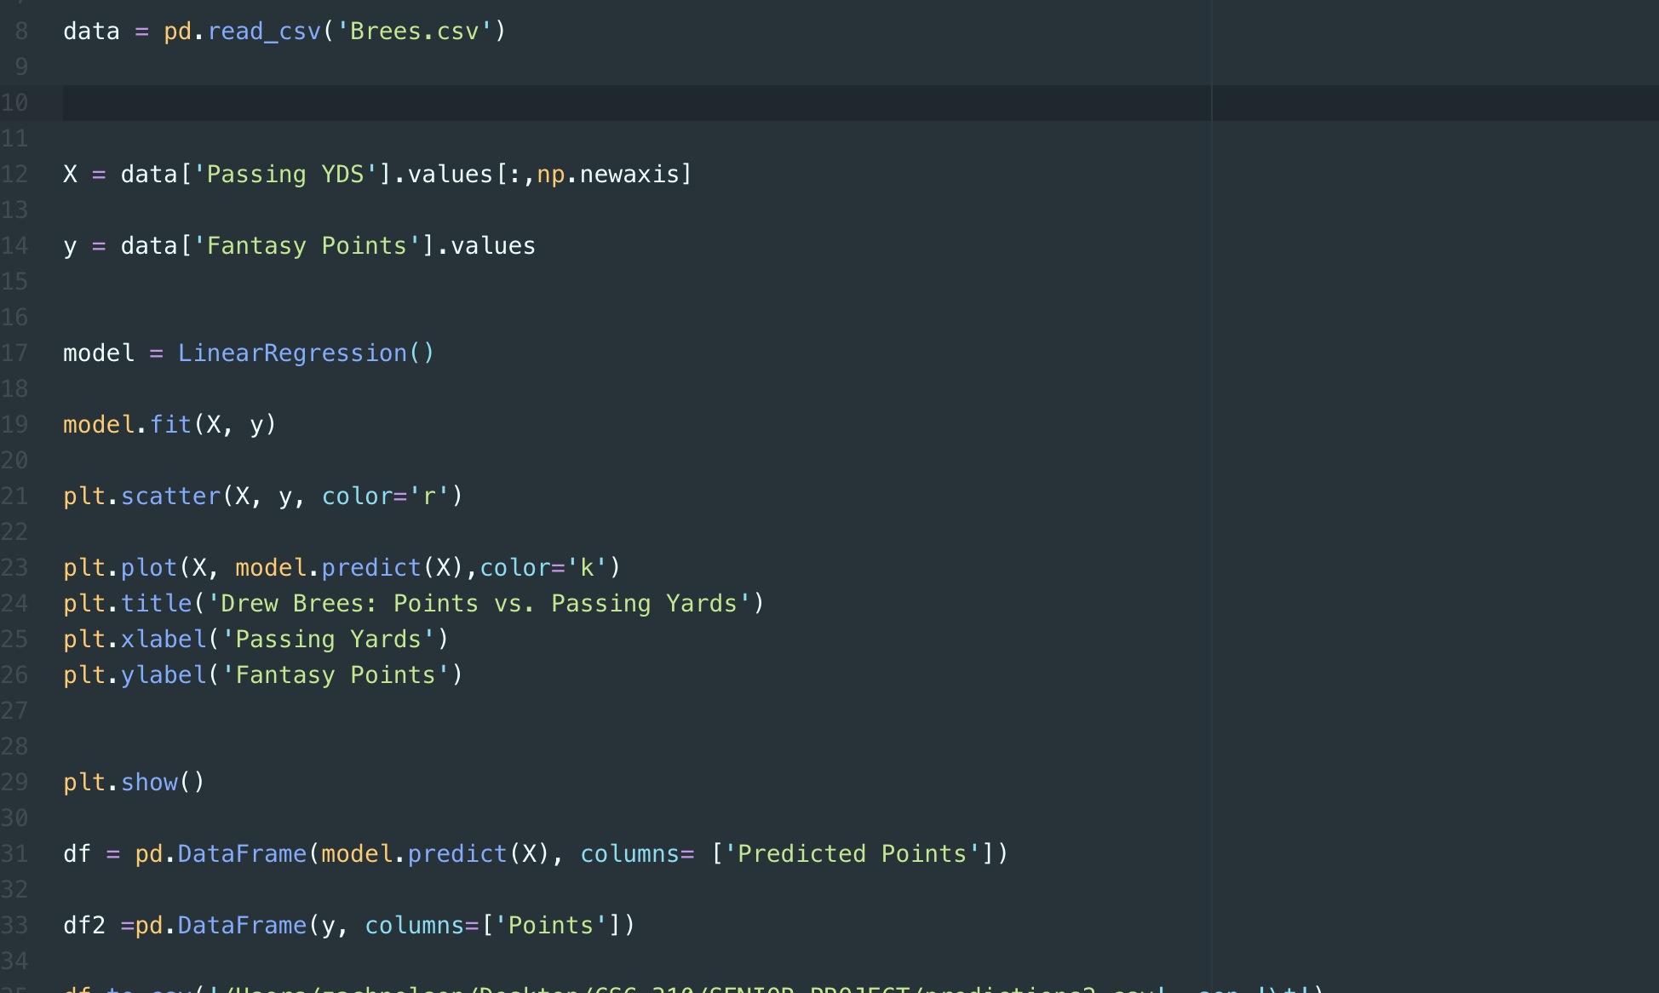
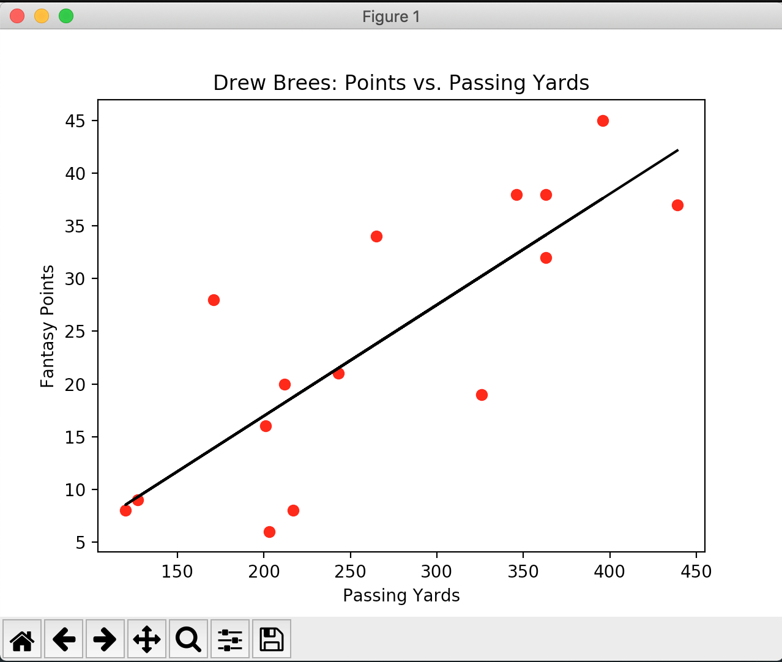

Slide 12
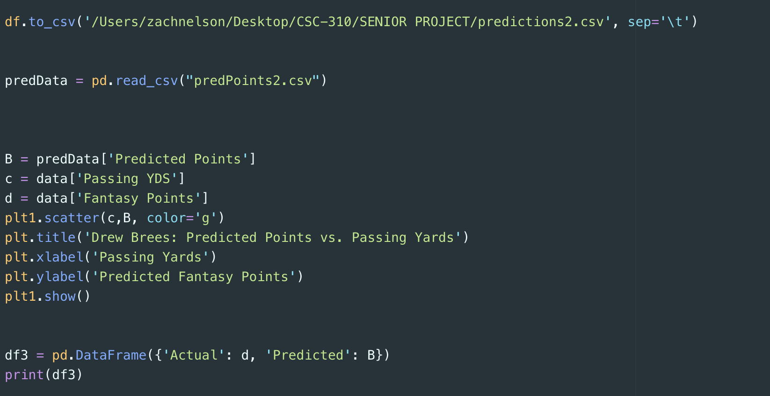
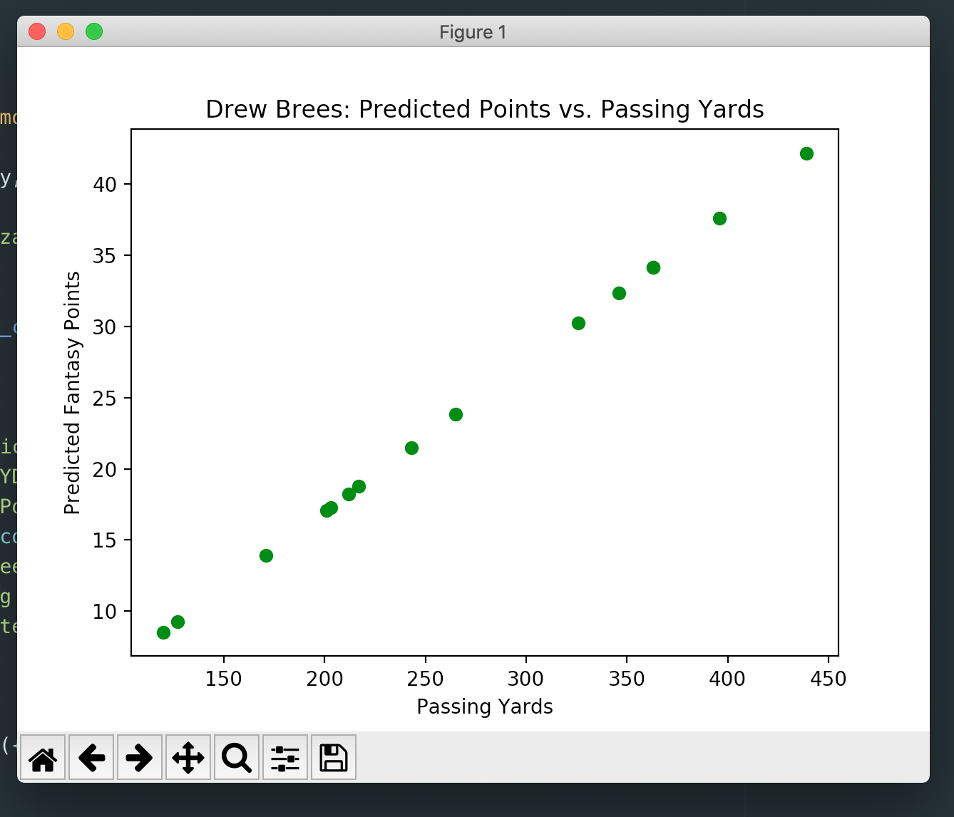

Slide 13
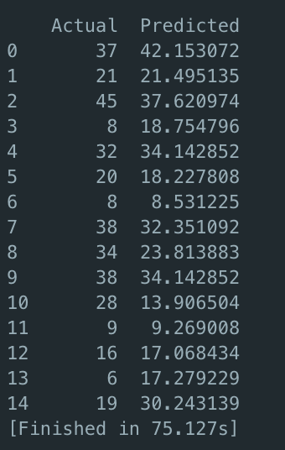
Results

Slide 14
With More Time We Would...
- Give users the ability to create accounts to track and save their players or team.
- Implement the linear regression applet on the web page for users to use for different players.
- Be able to expand the amount of data available for the users one each player across their active seasons as a NFL player

Slide 15
Questions?

